Slide 1


Time series analysis of aapl stock
Leon Zhu
UCLA Stats 418 – Tools in Data Science
Spring 2019
Department of Statistics

Slide 2
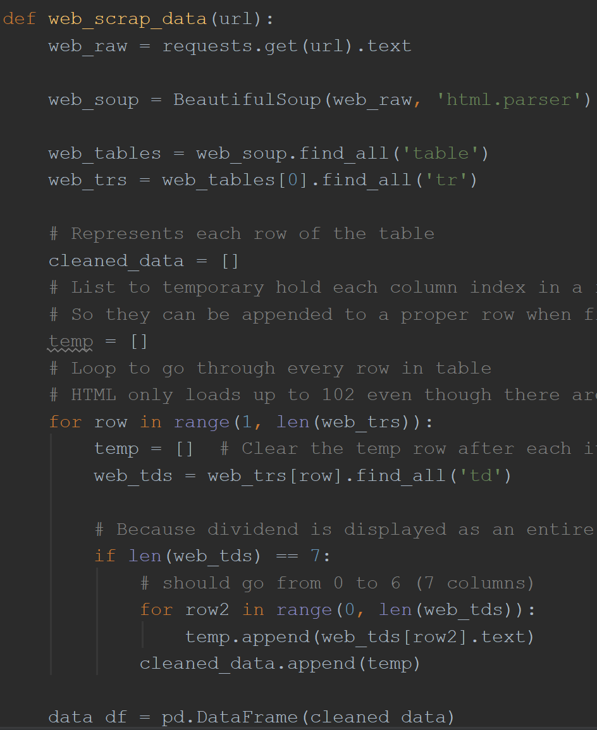
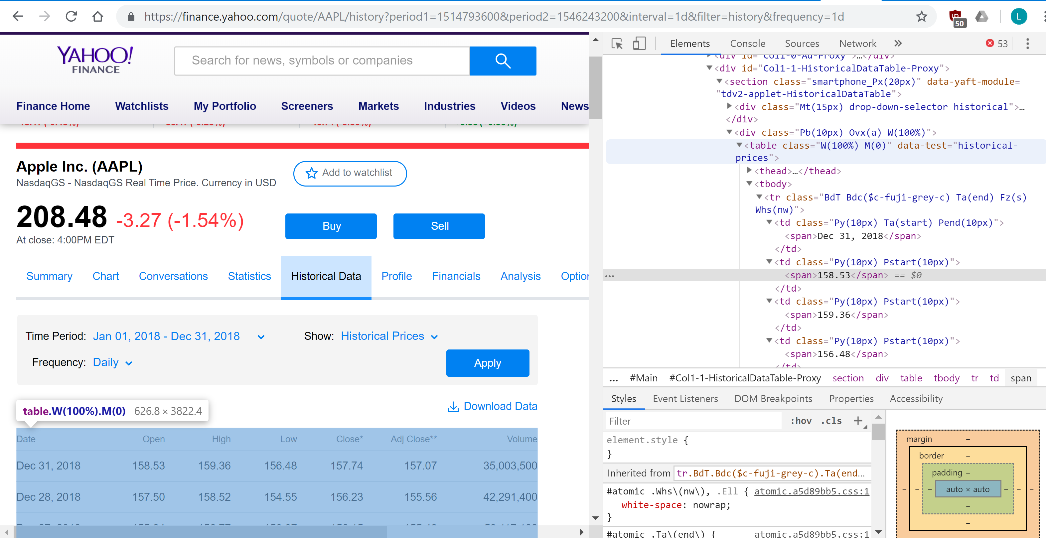
Attaining the dataset – Web Scrap
Department of Statistics

Slide 3
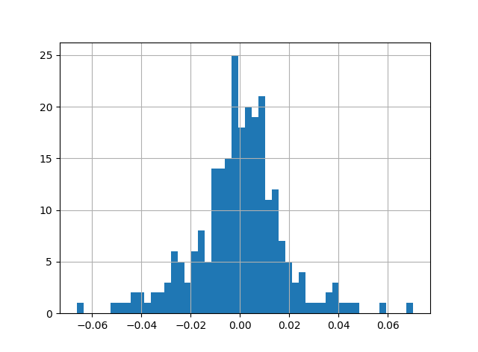
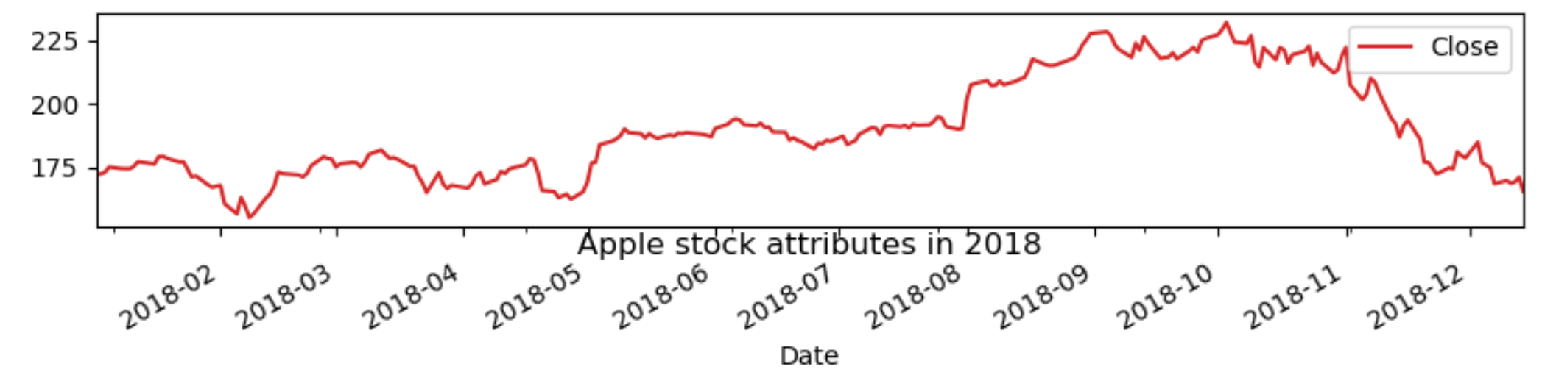
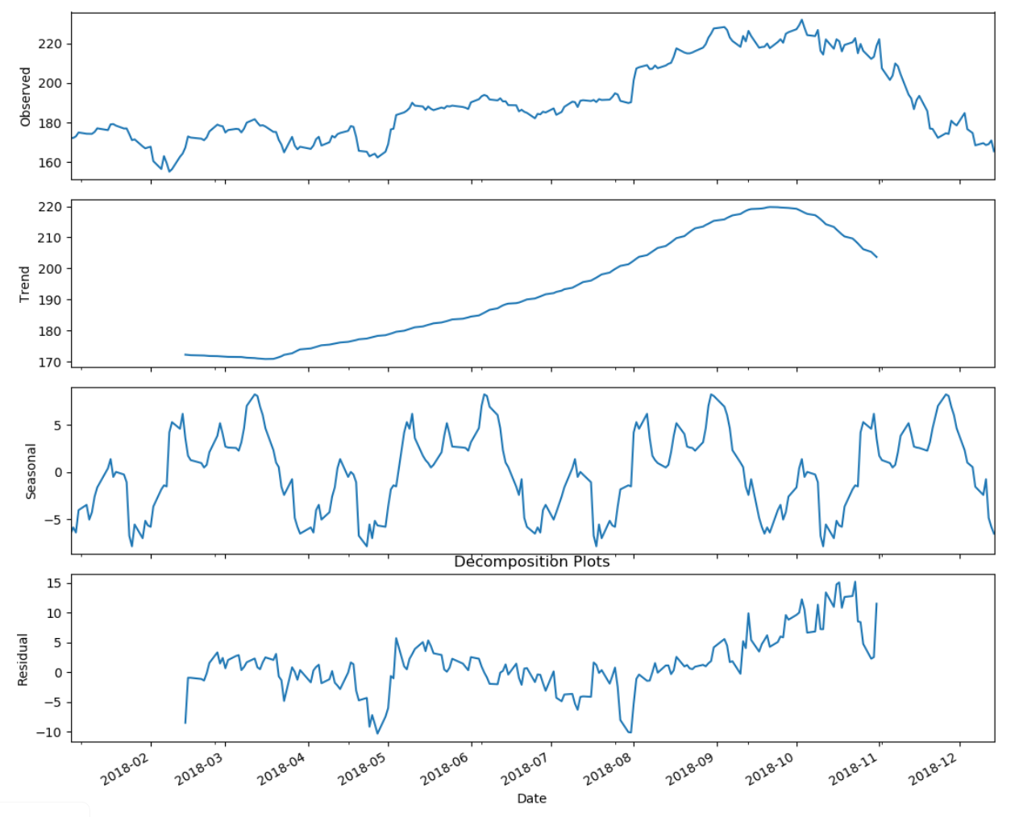
Exploratory Analysis
Histogram of the daily percent change
Department of Statistics

Slide 4
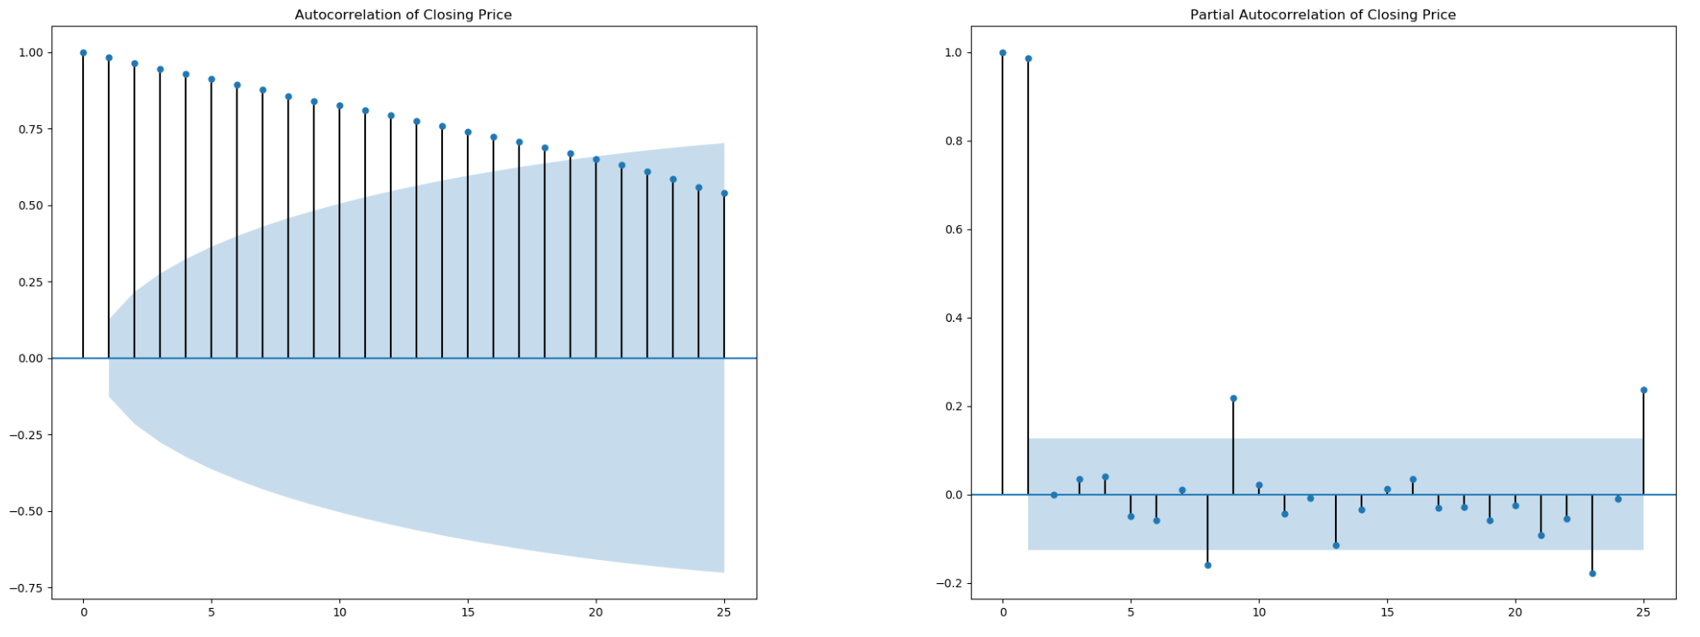
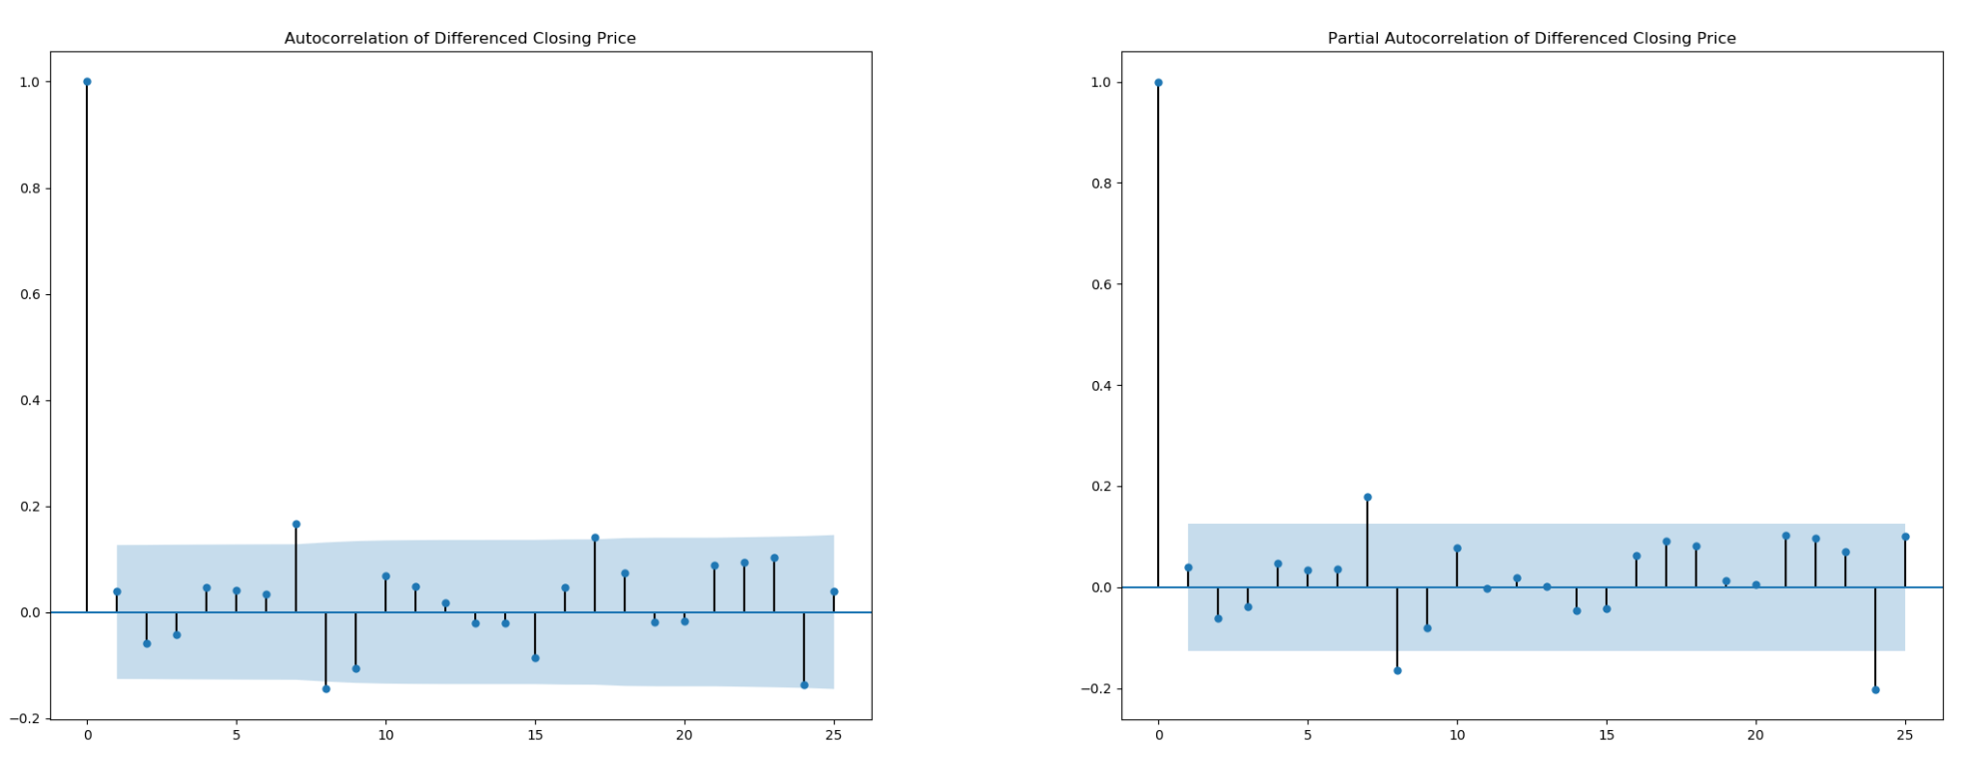
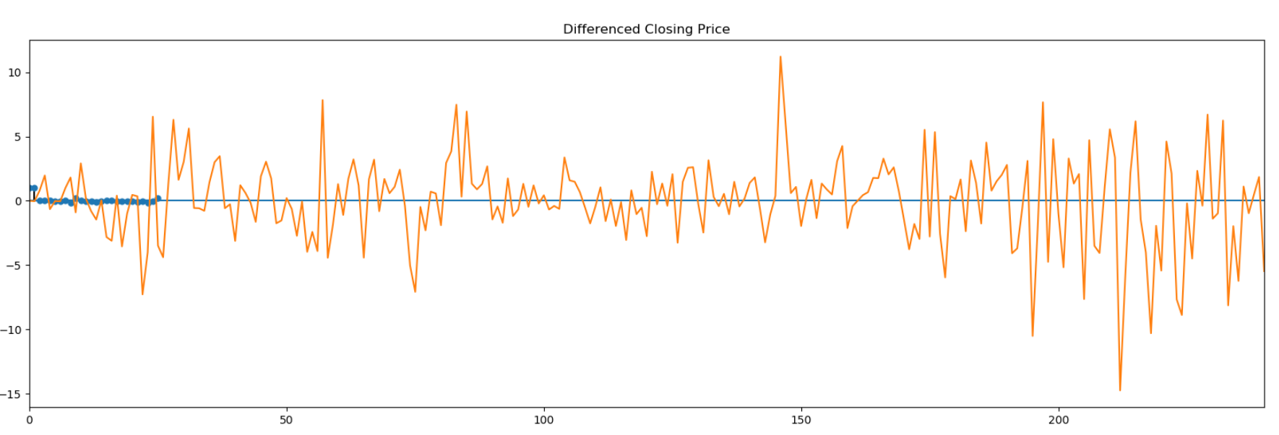
Exploratory Analysis
Department of Statistics

Slide 5
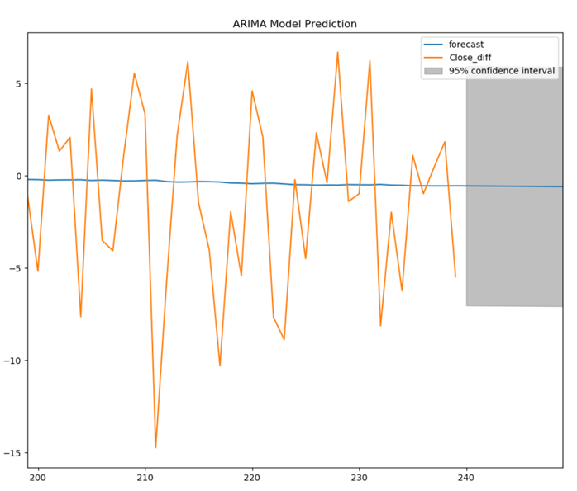
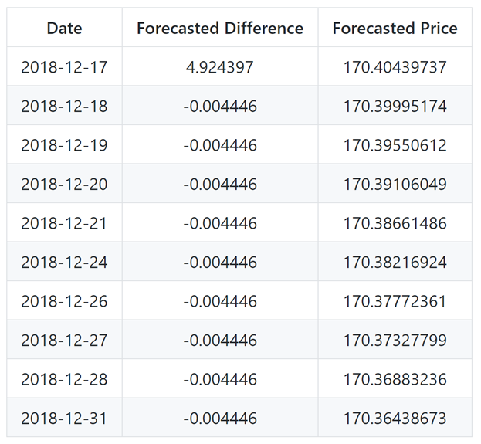
Model Analysis
RMSE: 5.0224385057219685
Department of Statistics

Slide 6



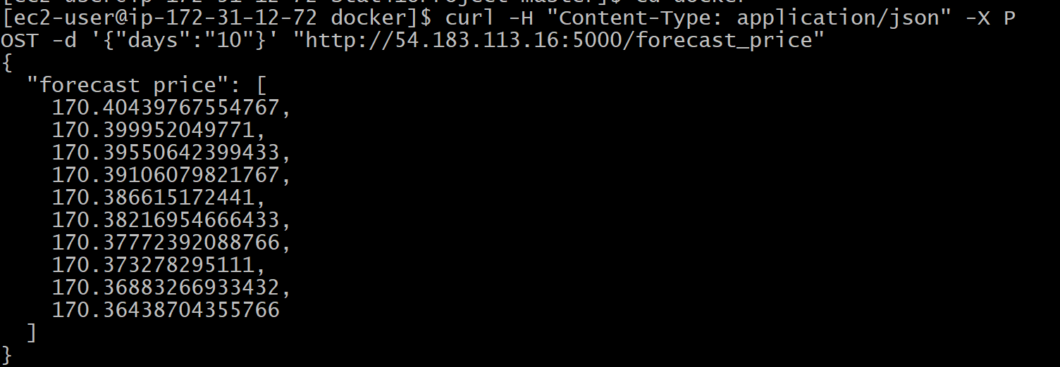
Deployment
Docker & Flask & AWS
Input: Desired number of days to forecast (from 2018-12-14)
Output: List of forecasted price for desired amount of days
curl -H "Content-Type: application/json" -X POST -d '{"days":"10"}' http://54.193.125.41:5000/forecast_price
{ "forecast price": [ 170.40439737, 170.39995174, 170.39550612, 170.39106049, 170.38661486, 170.38216924, 170.37772361, 170.37327799, 170.36883236, 170.36438673 ] }
Department of Statistics

